Slide 1
Fuzzy Logic and Fuzzy Control ECE 4740/5740 Professor Hanna

Slide 2
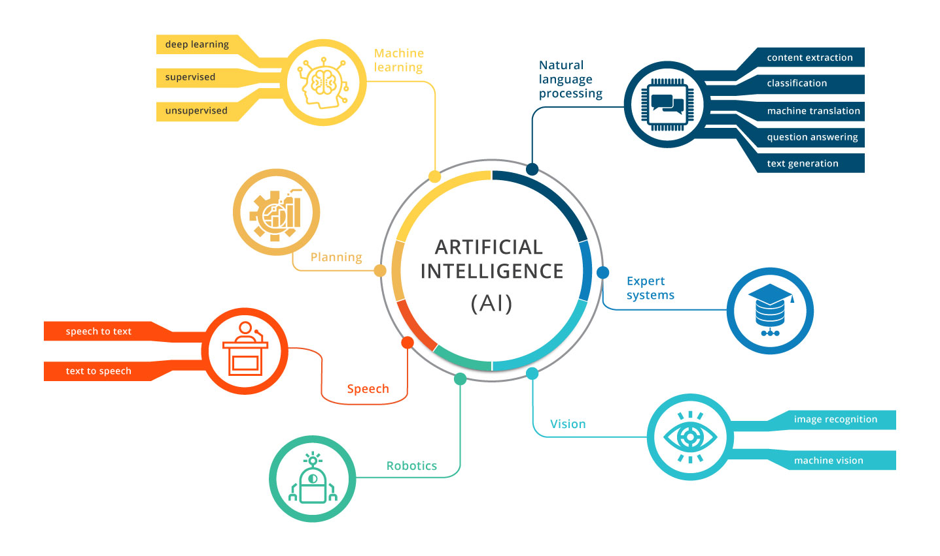
Artificial Intelligence

Slide 3
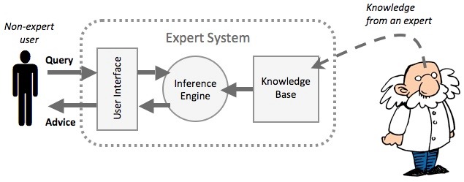
Expert Systems

Slide 4
Important Characteristics
Flexible and easy to implement machine learning technique
Helps you to mimic the logic of human thought
Logic has more than true and false
Highly suitable method for uncertain or approximate reasoning

Slide 5
Important Characteristics
Fuzzy logic views inference as a process of propagating elastic constraints
Fuzzy logic allows you to build nonlinear functions of arbitrary complexity
Fuzzy logic should be built with the complete guidance of experts

Slide 6

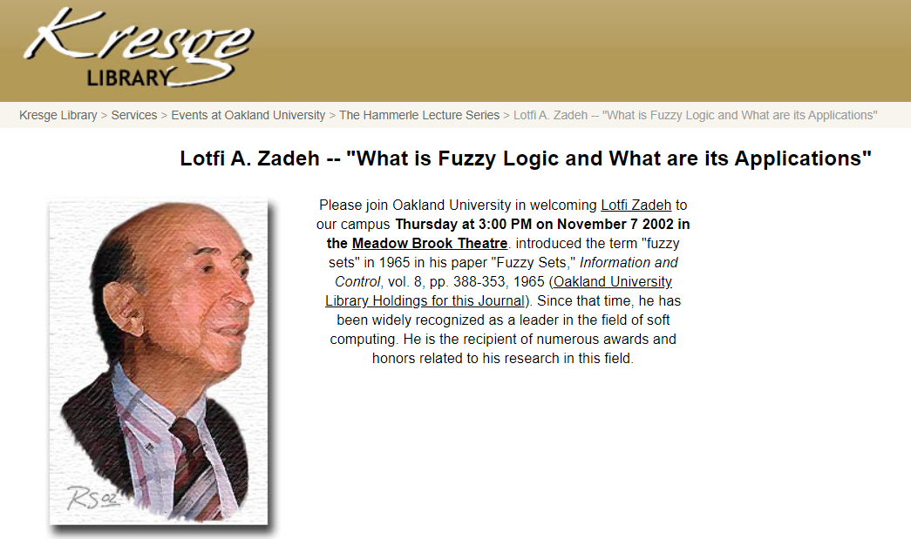
Discovery
Lotfi Zadeh
EECS Professor at UC-Berkeley
Discovered Fuzzy Logic in 1965
Died in 2017 at 96 years of age

Slide 7
Fuzzy Applications
Facial pattern recognition
Air conditioners
Washing machines
Vacuum cleaners
Antiskid braking systems
Transmission systems
Control of subway systems and unmanned helicopters

Slide 8
Fuzzy Applications
Knowledge-based systems for multi-objective optimization of power systems
Weather forecasting systems
Models for new product pricing or project risk assessment
Medical diagnosis and treatment plans
Stock trading

Slide 9
Fuzzy Control
Fuzzy Sets
Design of a Fuzzy Controller
Fuzzification of inputs: get_inputs()
Fuzzy Inference
Processing the Rules: find_rules()
Centroid Defuzzification
Output Defuzzification: find_output()
A Fuzzy Control Example --
Floating Ping-Pong Ball

Slide 10
Fuzzy Logic

Slide 11
Fuzzy Sets
Is this sentence true or false?

Slide 16
Probability vs. Fuzziness
Probability describes the uncertainty of an event occurrence.
Fuzziness describes event ambiguity.
Whether an event occurs is RANDOM.
To what degree it occurs is FUZZY.

Slide 17
Probability:
There is a 50% chance of an apple
being in the refrigerator.
Fuzzy: There is a half an apple in the refrigerator.

Slide 18
Fuzzy logic acknowledges and exploits the tolerance for uncertainty and imprecision.

Slide 19
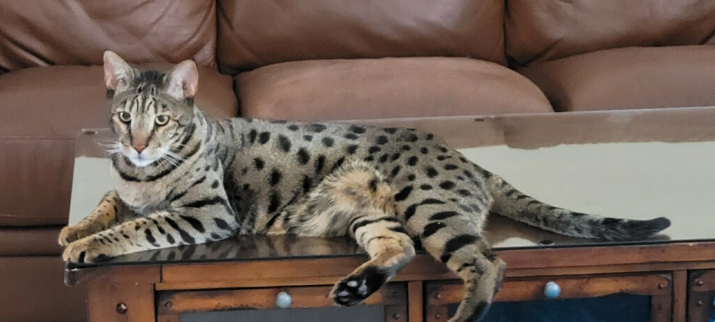
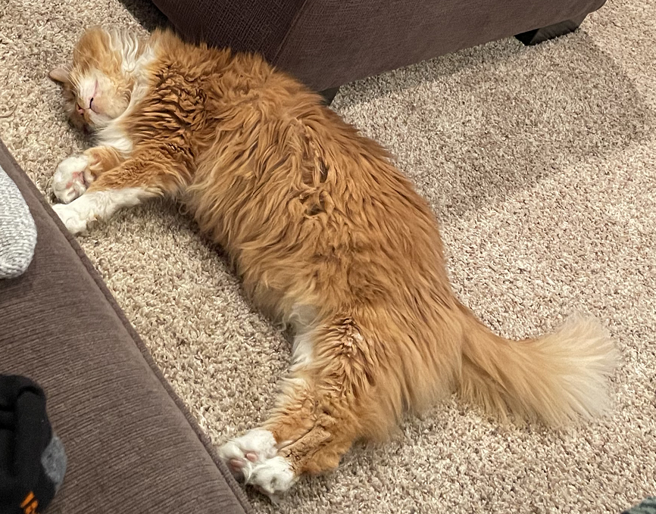
Fast
Spotted
sMart
Young
smalL
Old
F = {M,A}
S ={M}
M = {M}
Y = {M}
L = {}
O = {A}

Slide 20
Fast
Spotted
sMart
Young
smalL
Old
F = {(M,0.6), (A,0.4)}
S ={(M,0.7), (A,0.05)}
M = {(M,0.5), (A,0.4)}
Y = {(M,0.7), (A,0.1)}
L = {(M,0.1), (A,0.4)}
O = {M,0.2), A(,0.8)}

Slide 21
Fuzzy Set Operations
 | Crisp | Fuzzy
A U B = A + B | OR, PLUS | OR, MAX
A ∩ B = A * B | AND, MULTIPLY | AND, MIN
Crisp: A = {x, y}, B = {x, z}
A U B = {x, y, z}
A ∩ B = {x}
Fuzzy: A = {(x,0.4), (y,0.7)},
B = {(x,0.3), (z,0.8)}
A U B = {(x,0.4), (y,0.7)
, (z,0.8)}
A ∩ B = {(x,0.3)}

Slide 22
 | Crisp | Fuzzy
A U B = A + B | OR, PLUS | OR, MAX
A ∩ B = A * B | AND, MULTIPLY | AND, MIN
If a cat is Fast and Smart then the cat will SurVive
Fast
Spotted
sMart
Young
smalL
Old
F = {M,A}
S ={M}
M = {M}
Y = {M}
L = {}
O = {A}
V = {M}
What about Andy?

Slide 23
 | Crisp | Fuzzy
A U B = A + B | OR, PLUS | OR, MAX
A ∩ B = A * B | AND, MULTIPLY | AND, MIN
If a cat is Fast and Smart then the cat will SurVive
Fast
Spotted
sMart
Young
smalL
Old
F = {(M,0.6), (A,0.4)}
S ={(M,0.7), (A,0.05)}
M = {(M,0.5), (A,0.4)}
Y = {(M,0.7), (A,0.1)}
L = {(M,0.1), (A,0.4)}
O = {M,0.2), A(,0.8)}
V = {(M,0.5)
, (A,0.4)}
Assuming Survive is a crisp membership function of 1

Slide 24
Advantages
The structure of Fuzzy Logic Systems are easy and understandable
Fuzzy logic is widely used for commercial and practical purposes
It helps you to control machines and consumer products
It offers details surrounding acceptable reasoning
It helps you to deal with the uncertainty in engineering

Slide 25
Advantages
Mostly robust as no precise inputs required
It can be programmed to infer in the situation when feedback sensor stops working
It can easily be modified to improve or alter system performance
Inexpensive sensors can be used which helps you to keep the overall system cost and complexity low
It provides an effective solution to complex issues

Slide 26
Disadvantages
Fuzzy logic is not always accurate, so results are perceived based on assumption and it may not be widely accepted
Fuzzy systems don't have the capability of machine learning and generally don’t have neural network-type training with large datasets
Validation and Verification of a fuzzy knowledge-based system needs extensive testing with hardware
Setting acceptable fuzzy rules and membership functions can be a difficult task

Slide 27
Creating Membership Functions
Why do you prescribe one anti-depressant over another? There are 10 to choose from, add to that polypharmacy, there are 100s of combinations.
“It’s hard to explain”
Let’s go through case studies

Slide 29
Fuzzy Mathematics
Logic – Three Laws of Thought
Law of Identity
Law of the Excluded Middle
Law of Contradiction (a.k.a. non-contradiction)

Slide 30







Law of Identity
$$p∩U=p and p∪∅=p$$
Crisp: U = {a, b, c} A = {a, b}
$$\{a,b\} ∩U=\{a,b\}=A$$
$$\left\{a,b\right\}∪∅=\left\{a,b\right\}=A$$
Fuzzy: U = {a, b, c} A = {(a, 0.5), (b, 0.4)}
$$\{(a,0.5),(b,0.4)\} ∩U$$
$$\{(a,0.5),(b,0.4)\} ∩\{\left(a,1\right),\left(b,1\right),(c,1)\}$$
$$=\left\{\left(a,0.5\right),\left(b,0.4\right)\right\}=A$$
$$\{(a,0.5),(b,0.4)\} ∪∅$$
 | Crisp | Fuzzy
A U B = A + B | OR, PLUS | OR, MAX
A ∩ B = A * B | AND, MULTIPLY | AND, MIN
$$\{(a,0.5),(b,0.4)\}∪\{\left(a,0\right),\left(b,0\right),\left(c,0\right)\}$$
$$=\left\{\left(a,0.5\right),\left(b,0.4\right)\right\}=A$$

Slide 31

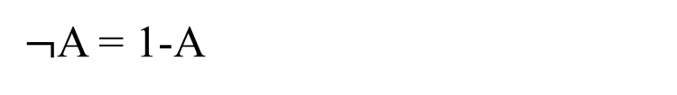
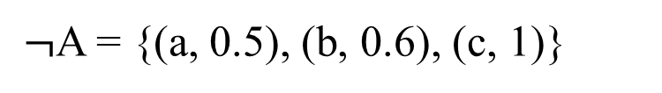

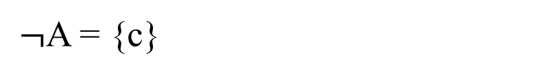
Law of the Excluded Middle
$$p ∪¬p=U (true)$$
Crisp: U = {a, b, c} A = {a, b}
$¬$A = {c}
$$A ∪¬A=\left\{a,b,c\right\}= U$$
Fuzzy: U = {a, b, c} A = {(a, 0.5), (b, 0.4), (c, 0)}
$¬$A = 1-A
$¬$A = {(a, 0.5), (b, 0.6), (c, 1)}
 | Crisp | Fuzzy
A U B = A + B | OR, PLUS | OR, MAX
A ∩ B = A * B | AND, MULTIPLY | AND, MIN
$$A ∪¬A=\text{\{(}\text{a}\text{, 0.5), (}\text{b}\text{, 0.6), (}\text{c}\text{, 1)\}}≠ U$$

Slide 32



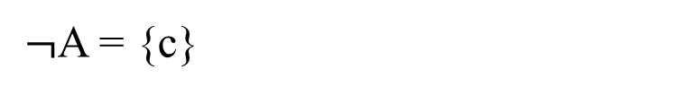
Law of Contradiction (a.k.a. non-contradiction)
$$p ∩¬p=∅$$
Crisp: U = {a, b, c} A = {a, b}
$¬$A = {c}
$$A ∩¬A=\{\}= ∅$$
Fuzzy: U = {a, b, c} A = {(a, 0.5), (b, 0.4)}
$¬$A = 1-A
$¬$A = {(a, 0.5), (b, 0.6), (c, 1)}
 | Crisp | Fuzzy
A U B = A + B | OR, PLUS | OR, MAX
A ∩ B = A * B | AND, MULTIPLY | AND, MIN
$$A ∩¬A=\text{\{(}\text{a}\text{, 0.5), (}\text{b}\text{, 0.4)\}}≠ ∅$$

Slide 33
Fuzzy Control
Fuzzy Sets
Design of a Fuzzy Controller
Fuzzification of inputs: get_inputs()
Fuzzy Inference
Processing the Rules: find_rules()
Centroid Defuzzification
Output Defuzzification: find_output()
A Fuzzy Control Example --
Floating Ping-Pong Ball

Slide 36
A Fuzzy Controller

Slide 38
Fuzzy Control
Fuzzy Sets
Design of a Fuzzy Controller
Fuzzification of inputs: get_inputs()
Fuzzy Inference
Processing the Rules: find_rules()
Centroid Defuzzification
Output Defuzzification: find_output()
A Fuzzy Control Example --
Floating Ping-Pong Ball

Slide 42
Fuzzy Control
Fuzzy Sets
Design of a Fuzzy Controller
Fuzzification of inputs: get_inputs()
Fuzzy Inference
Processing the Rules: find_rules()
Centroid Defuzzification
Output Defuzzification: find_output()
A Fuzzy Control Example --
Floating Ping-Pong Ball

Slide 43
Fuzzy Inference

Slide 44
 | Crisp | Fuzzy
A U B = A + B | OR, PLUS | OR, MAX
A ∩ B = A * B | AND, MULTIPLY | AND, MIN

Slide 45
 | Crisp | Fuzzy
A U B = A + B | OR, PLUS | OR, MAX
A ∩ B = A * B | AND, MULTIPLY | AND, MIN

Slide 46
Fuzzy Control
Fuzzy Sets
Design of a Fuzzy Controller
Fuzzification of inputs: get_inputs()
Fuzzy Inference
Processing the Rules: find_rules()
Centroid Defuzzification
Output Defuzzification: find_output()
A Fuzzy Control Example --
Floating Ping-Pong Ball

Slide 49
Rules

Slide 50
Fuzzy Control
Fuzzy Sets
Design of a Fuzzy Controller
Fuzzification of inputs: get_inputs()
Fuzzy Inference
Processing the Rules: find_rules()
Centroid Defuzzification
Output Defuzzification: find_output()
A Fuzzy Control Example --
Floating Ping-Pong Ball

Slide 58
 | Crisp | Fuzzy
A U B = A + B | OR, PLUS | OR, MAX
A ∩ B = A * B | AND, MULTIPLY | AND, MIN

Slide 59
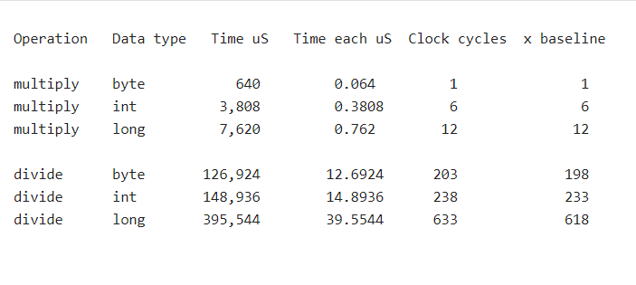
Arduino

Slide 60
Fuzzy Control
Fuzzy Sets
Design of a Fuzzy Controller
Fuzzification of inputs: get_inputs()
Fuzzy Inference
Processing the Rules: find_rules()
Centroid Defuzzification
Output Defuzzification: find_output()
A Fuzzy Control Example --
Floating Ping-Pong Ball

Slide 62
Fuzzy Control
Fuzzy Sets
Design of a Fuzzy Controller
Fuzzification of inputs: get_inputs()
Fuzzy Inference
Processing the Rules: find_rules()
Centroid Defuzzification
Output Defuzzification: find_output()
A Fuzzy Control Example --
Floating Ping-Pong Ball

Slide 63
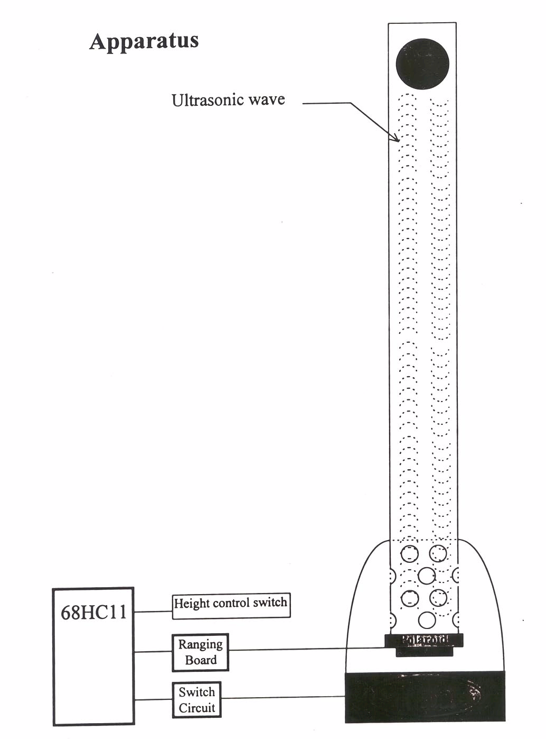
68HC12
Zynq
PL. ..

Slide 64
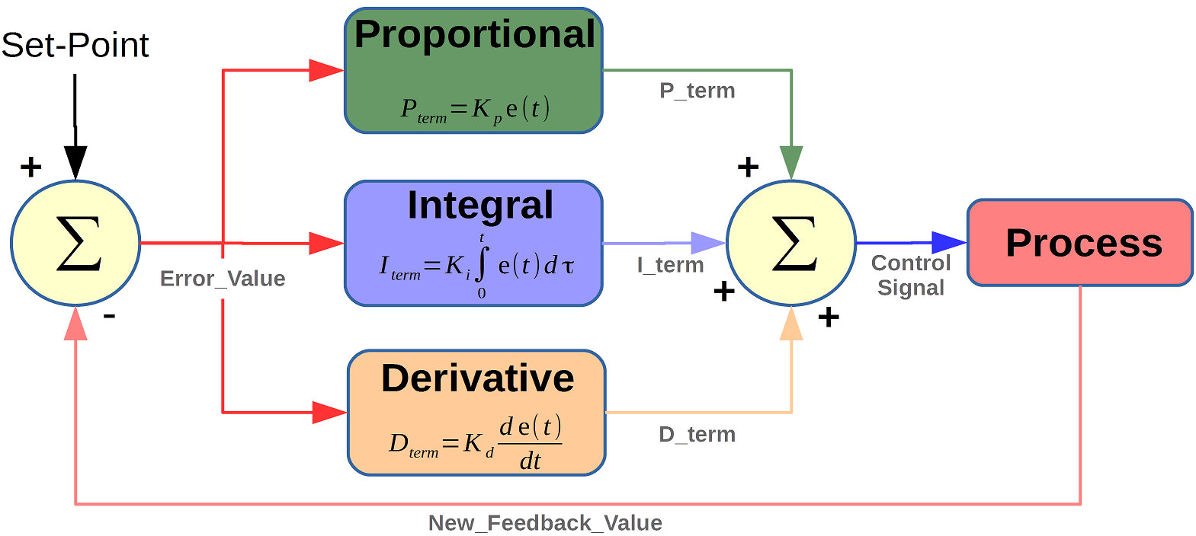
PID Controller
Proportional Response - the proportional component depends only on the difference between the set point and the process variable.
Integral Response - sums the error term over time.
Derivative Response - proportional to the rate of change of the process variable.

Slide 65
Fuzzy k-map for floating ping-pong ball

Slide 66
An alternative: doesn’t have to have equal coverage

Slide 67
Implementations
High-level Languages
C
Java
Assembly
Assembly
Assembly Built-in Fuzzy Control Instructions
HC12

Slide 68
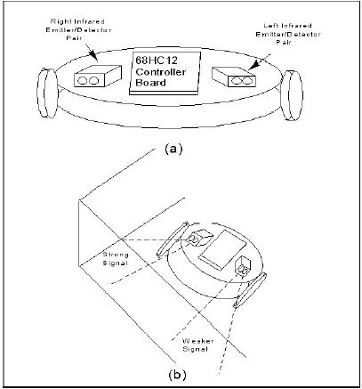
Designing a Robot (Example)

Slide 69
Designing a Robot (Example)
Determine the membership functions that will be needed to describe all inputs to the controller
Left sensor input: very weak, weak, medium, strong, very strong
Right sensor input: very weak, weak, medium, strong, very strong
Each must be defined with a set of input membership functions. For the HC12 a trapezoidal function must be used.

Slide 70
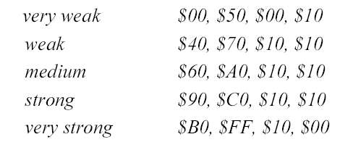
Designing a Robot (Example)
Design the membership functions. They may be triangular or trapezoidal.
For trapezoidal functions, specify them with the farthest left point, farthest right point, left slope, and right slope
Full membership corresponds to $FF – for each sensor

Slide 71
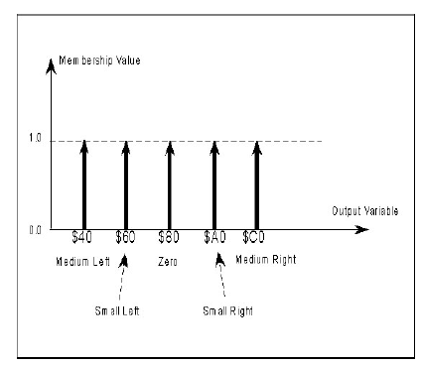
Designing a Robot (Example)
Design the output membership function or use singletons.
Medium Left $40, Small Left $60, Zero $80, Small Right $A0, Medium Right $C0
Assuming $80 keeps the robot on a straight path.

Slide 72
Designing a Robot (Example)
Determine fuzzy rules that map input to output membership functions. Rules are intuitive and based on considering all possible sensor input values scenarios.
Rules can be of the form:
IF antecedent 1 AND antecedent 2, THEN desired output

Slide 73
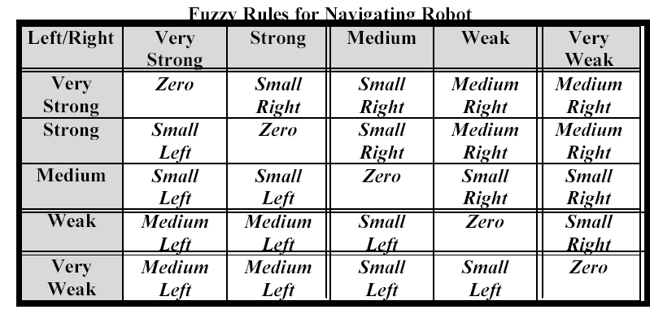
Designing a Robot (Example)

